Slide 1
Radical Classification
Noa Ryan and Geoffrey Bridgman

Slide 2
It is here that a culture, imperceptibly deviating from the empirical orders prescribed for it by its primary codes, instituting an initial separation from them, causes them to lose their original transparency, relinquishes its immediate and invisible powers, frees itself sufficiently to discover that these orders are perhaps not the only possible ones or the best ones; this culture then finds itself faced with the stark fact that there exists, below the level of its spontaneous orders, things that are in themselves capable of being ordered, that belong to a certain unspoken order; the fact, in short, that order exists.
Michel Foucault, The Order of Things

Slide 3
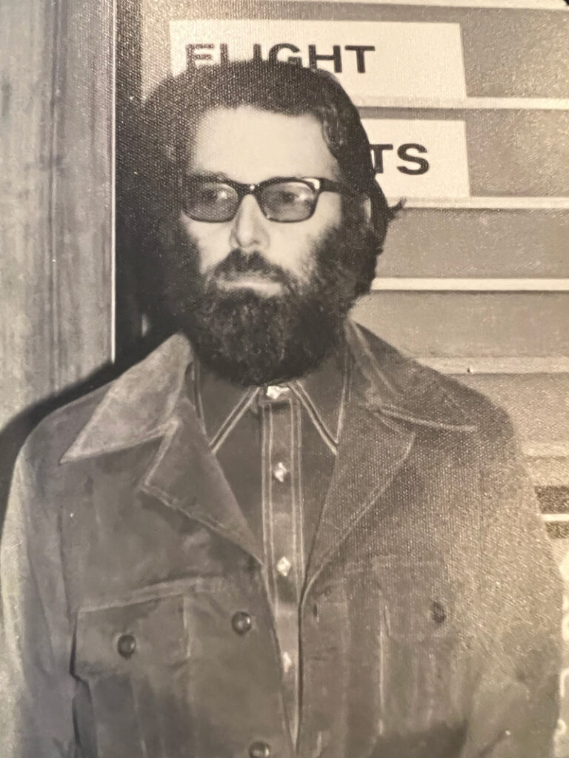
Sandford (AKA Sandy) Berman
Used Subject Headings to combat “Bibliocide by Cataloging”
–1971 publication Prejudices and Antipathies is credited with sparking a movement to correct biased subject headings. Worked at the Hennepin County Public Library (in Minneapolis) with far more exhaustive subject headings than most, including increased access points to literature that would be of interest to marginalized groups and to people in the many liberation movements of that time.

Slide 4
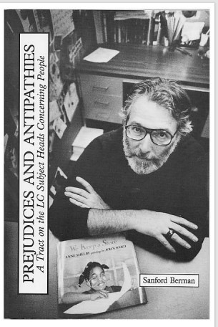
Sanford (aka Sandy) Berman
“If you’re a bank manager, real estate broker, or stock market player, you’ll emphatically dig at least one large, well-funded public library in the LA area. It’s got everything to satisfy the financier and major-league rip-off artist… and a number of expensive investors’ services like Moody’s and Standard & Poor. But if you’re young, hip, radical, impecunious, Black, Chicano, or into one of the many ‘liberation’ scenes, you won’t dig it so much.” —Sandford Berman (50 REVOLTING LIBRARIANS)
“Still, longhaired freaks and madassed revolutionaries are as much members of the community as Big Money Makers and hard-hat ‘straights.’ Some even pay taxes or tuition…”
—Sandford Berman (50 REVOLTING LIBRARIANS)

Slide 5

Brian Deer – the Brian Deer Classification System
“Underlying the Brian Deer system is a critique of library classification, though Deer himself never committed one to writing… Others have been left to do this – to argue that First Nations ways of perceiving the world do not fit the pigeonholes of classifications created by a different culture.”
MacDonell, Tagami, and Washington in The Brian Deer Classification System

Slide 6

Gene Joseph – X̱wi7x̱wa Library
Worked at the Union of BC Indian Chiefs after Brian Deer, modifying the Brian Deer Classification System he implemented there for BC-specific materials
Became founding librarian of the X̱wi7x̱wa Library (formerly the Indian Education Resource Centre), which uses a modified BD Classification System and a custom local list of ~11,000 subject headings: the First Nation House of Learning Subject Headings file

Slide 7
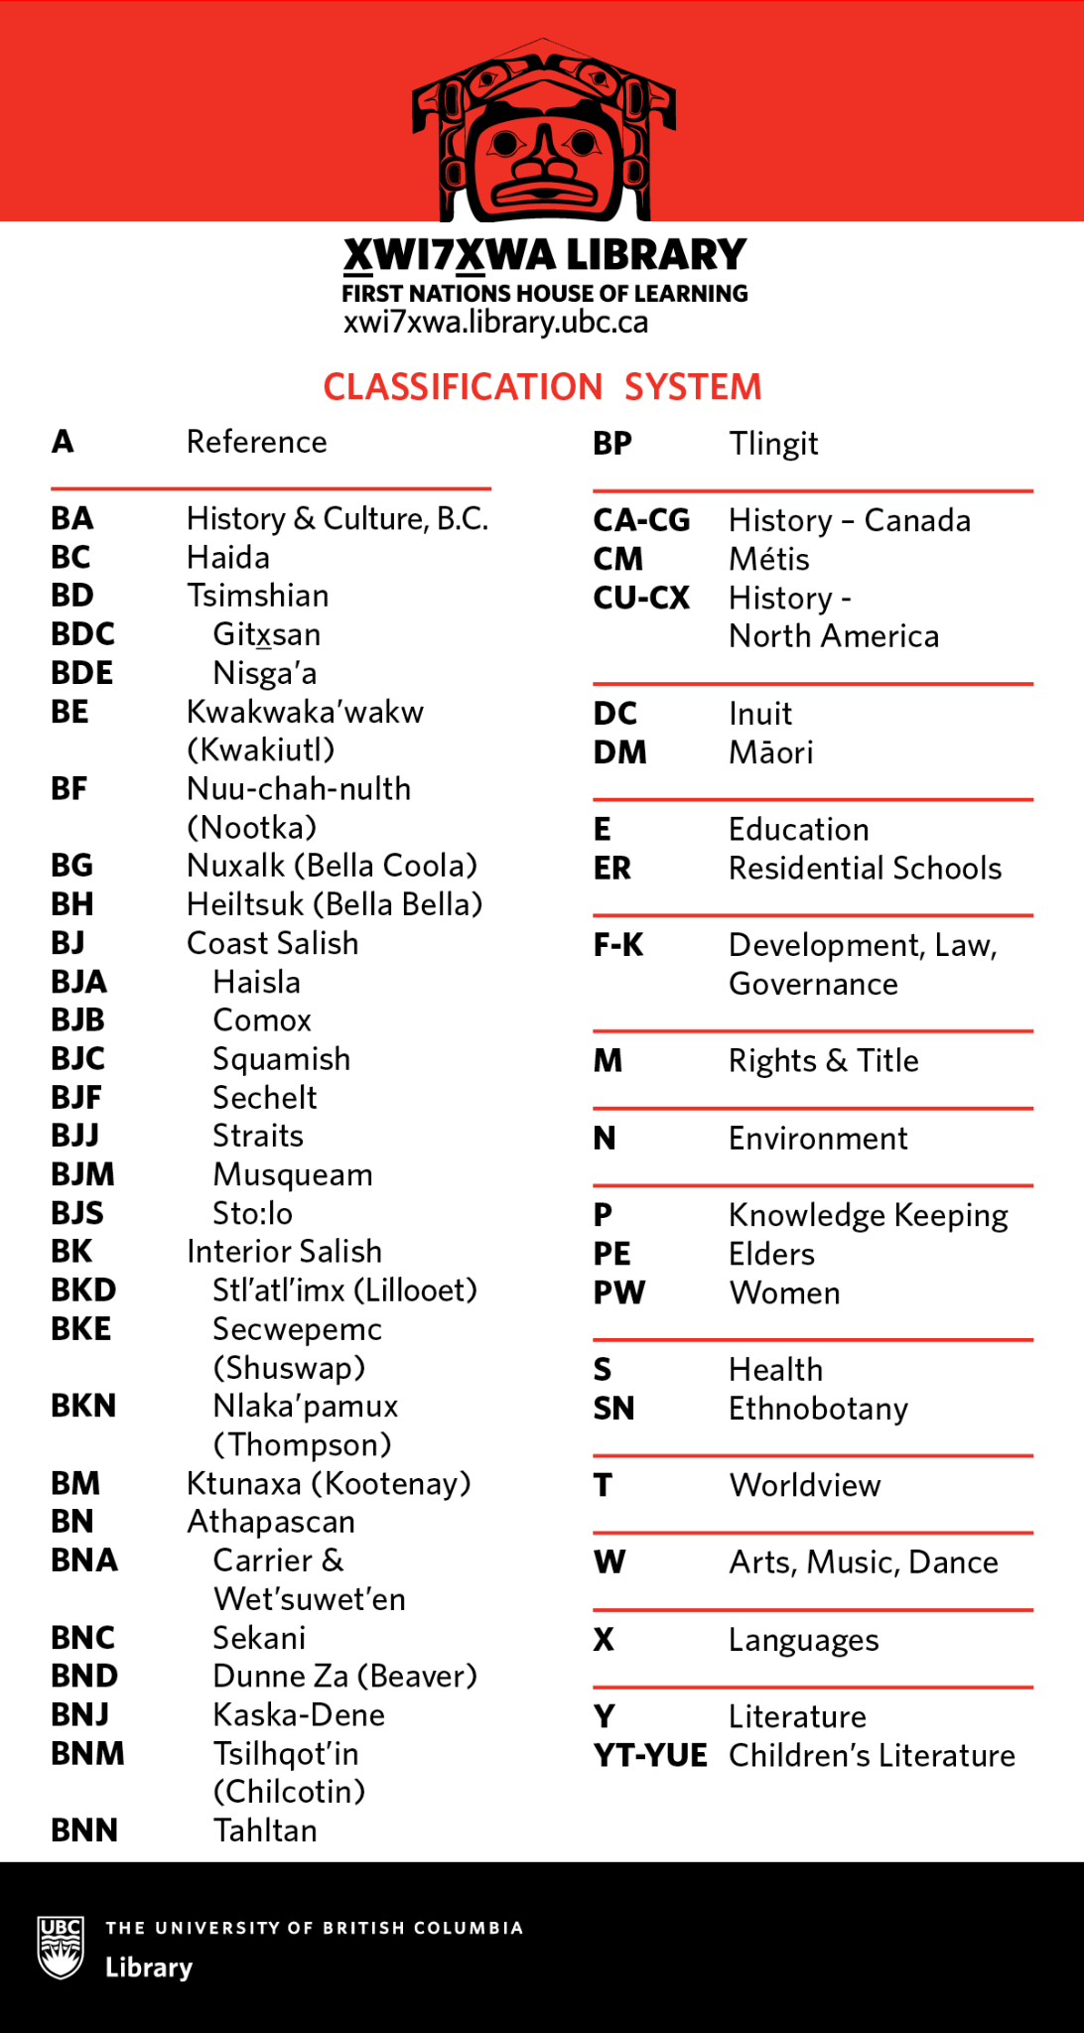

X̱wi7x̱wa Classification System
Example:
CX H35 I53 2023
CX = HISTORY > NORTH AMERICA
H35 = HÄMÄLÄINEN
I53 = INDIGENOUS
2023 = year of publication

Slide 8
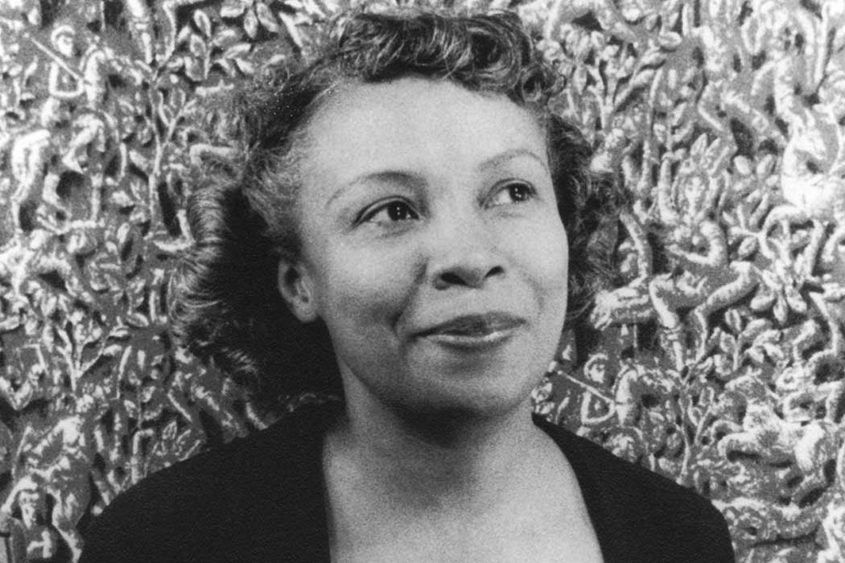
Dorothy Porter — the Moorland-Spingarn Collection
“David Levering Lewis, biographer of W.E.B. Du Bois and Martin Luther King Jr., says he cannot imagine anyone who has written about African American history who has not benefited from Porter's work. The Moorland-Spingarn collection, he says, has been indispensable to his research and "it's unimaginable that it would have achieved that kind of capacity without Dorothy Porter's early stewardship." (The Undimmed Light, Washington Post)

Slide 9
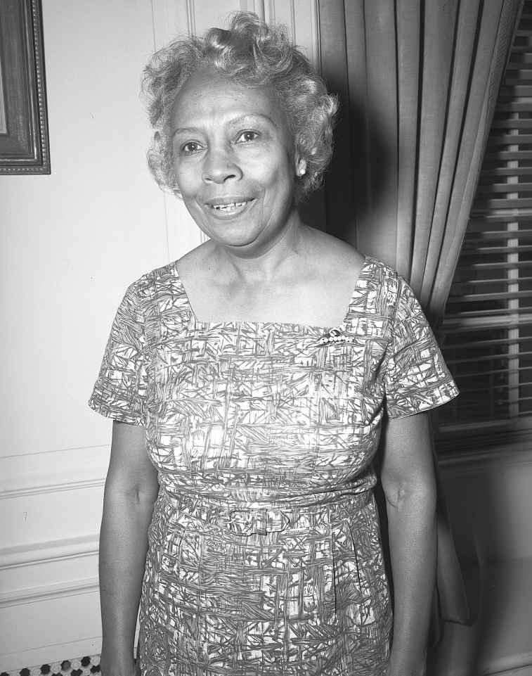
Dorothy Porter
"When I started building the collection, nobody was writing about blacks in history. You couldn't find any books."
—Dorothy Porter (Zita Cristina Nunes for Smithsonian Magazine)
"The only rewarding thing for me is to bring to light information that no one knows. What's the point of rehashing the same old thing?"
—Dorothy Porter (Zita Cristina Nunes for Smithsonian Magazine)

Slide 10
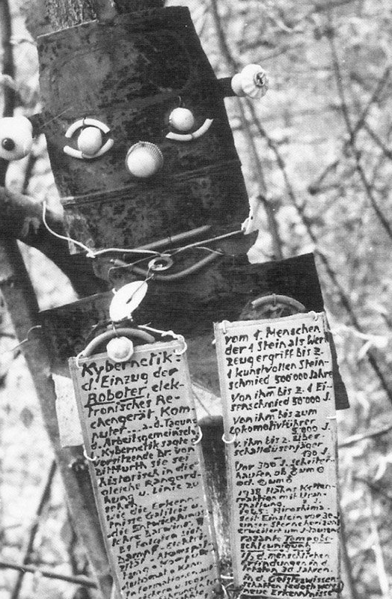
Armand Schulthess – Encyclopedic Garden
“He embarked on the task of laying out his 18,000sq meter property with a network of paths, bridges, stairways and ladders. From the trees, by means of wire, he hung hundreds of metal plaques made from the tops or bases of food tins, which he coated with paint and inscribed with messages. The texts, written in five languages, combine knowledge relating to geology, astrology, psychoanalysis, literature and music, among other subjects.”

Slide 11
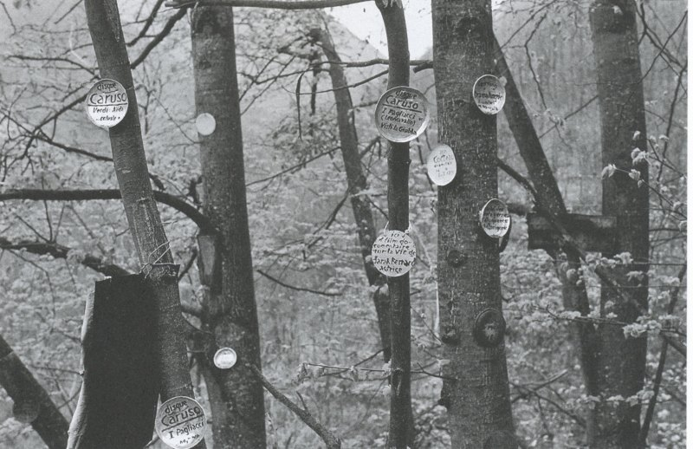


Slide 12

TERRY BELANGER’S “LUNACY AND THE ARRANGEMENT OF BOOKS”
“There was a time when I loved to see my books arranged with a view to uniformity of height and harmony of color without respect to subjects. That time I regard as my vealy period.” His tastes eventually evolved to allow for “a little artistic confusion—high and low together here and there, like a democratic community … just as children in velvet and furs sit next to a newsboy, or a little girl in calico with a pigtail at Sunday school, or as beggars and princes kneel side by side on the cathedral pavement”
– Terry Belanger (Lunacy and the Arrangement of Books)

Slide 13
Works Cited
Augustyn, Frederick. “Cataloging the 1990s: Sandy Berman’s Challenge to LC.” The Library of Congress Information Bulletin. Feb 22, 1993. Accessed by: https://www.loc.gov/loc/lcib/93/9304/berman.html
Belanger, Terry. Lunacy and the Arrangement of Books. Oak Knoll Books. 1982.
Berman, Sandy, and Danky, James, editors. Alternative Library Literature, 1996/1997 A Biennial Anthology. McFarland & Company. 1998.
Berman, Sandford. “Libraries to the People.” Revolting Librarians. Bootlegger Press. 1972.
“Celeste West.” Wikipedia, The Free Encyclopedia, Wikimedia Foundation, 22 August 2023 last updated. Accessed by: https://en.wikipedia.org/wiki/Celeste_West
“Dorothy B. Porter.” Wikipedia, The Free Encyclopedia, Wikimedia Foundation, 26 November 2023 last updated. Accessed by: https://en.wikipedia.org/wiki/Dorothy_B._Porter
Gurlyard, Burl. “Sandy Berman’s Last Stand.” City Pages. July 14. 1999. Accessed by: https://www.sanfordberman.org/cityp/ber1t.htm
Katz, Elizabeth, and West, Celeste, editors. Revolting Librarians. Booklegger Press. 1972.
Nunes, Zita Cristinia. “Remembering the Howard University Librarian Who Decolonized the Way Books Were Catalogued.” Smithsonian Magazine. 26 November 2018. Accessed by: https://www.smithsonianmag.com/history/remembering-howard-university-librarian-who-decolonized-way-books-were-catalogued-180970890/
Weeks, Linton. “The Undimmed Light.” Washington Post. 15 Nov. 1995.

